Slide 1

How to protect Organizations in terms of Data and Network Security ?
PRESENTED BY :- SNEHAL TAWAR

Slide 2

What is network security?
Network security is any activity designed to protect the usability and integrity of your network and data. It includes both hardware and software technologies.
Effective network security manages access to the network. It targets a variety of threats and stops them from entering or spreading on your network.
Network security also incorporates the policies and procedures you put in place to protect your assets such as password management, two-factor authentication and even three-factor authentication such as fingerprint identification and facial or retinal scans.

Slide 3

Types of network security:
Access control
Antivirus and antimalware software
Application security
Behavioral analytics
Data loss preventing
Email security
Firewalls
Intrusion prevention systems
Mobile device security
Network segmentation
Security information and event management
VPN
Web security
Wireless security

Slide 4


Importance of network security:
More importantly, relying solely on a firewall presents a single-point of failure. Aside from the denial of service attacks against your perimeter, modern networks are under increasing risk of being penetrated through supply-chain attacks, DNS hijacking, phishing and spear-phishing campaigns and file less malware, to name just a few.
Network security is also not just about external threats, but also the misuse or abuse of data and company assets by internal threats, too.
How does modern network security work?
Because of the need to protect at more than just the perimeter, modern network security takes a defense in depth approach.
The attack surface is very vast, so you need a response plan, aided and abetted by security solutions that can take autonomous action to remediate threats when they are detected.

Slide 5

Data as an asset & Business reputation
Data security refers to the process of protecting data from unauthorized access and data corruption throughout its lifecycle. Data security includes data encryption, tokenization, and key management practices that protect data across all applications and platforms.
When there is a security breach, there is more than just money at stake. Flawed data security puts all your clients at risk, and as a consequence also the future of your business. Reputation takes years to build and seconds to destroy.

Slide 6

Ways You Can Ensure Improved Data Security:
Manage who has access
Know and protect your most important data
Develop a data security plan/policy
Develop stronger passwords throughout your organization
Regularly backup data

Slide 7
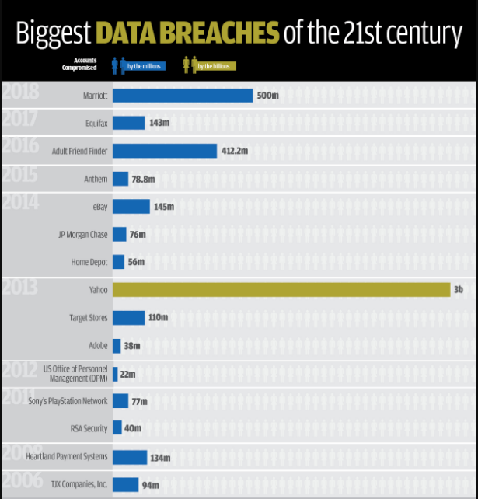

Slide 8

Conclusion:
It is important for your organization to deliver services customers and employees demand, but to do so you need to protect your network and data.
Good network security not only helps protect your IP and customer data, it also protects your reputation. By combining multiple layers of defense throughout your network – not just at the perimeter – with appropriate policies, controls and a Next-Gen endpoint security solution, you can give authorized users access to the network resources they need while blocking those trying to carry out attacks.

Slide 9
THANK YOU.

